Slide 1
Decision Tree Classification (CART) Algorithm
Done by:
Raivatha K M

Slide 2
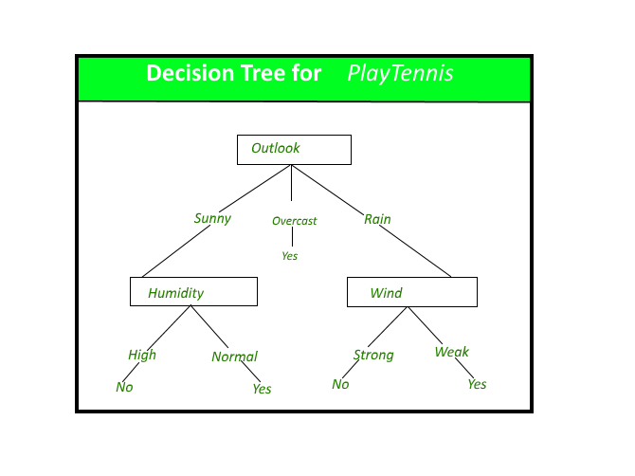
Decision Tree
It is the most powerful and popular tool for classification and prediction. A Decision tree is a flowchart-like tree structure, where each internal node denotes a test on an attribute, each branch represents an outcome of the test, and each leaf node (terminal node) holds a class label.

Slide 3
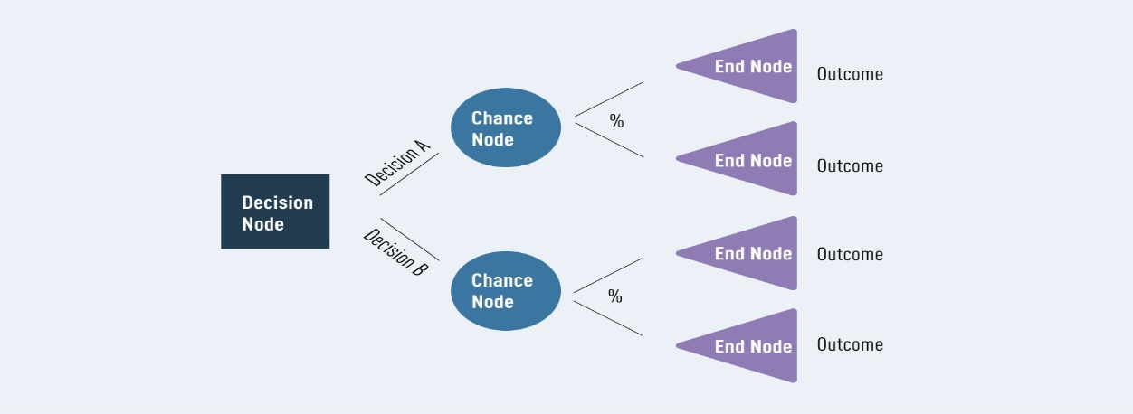
Root nodes-In the diagram above, the blue decision node is what we call a ‘root node.’ This is always the first node in the path. It is the node from which all other decision, chance, and end nodes eventually branch.
Leaf nodes-In the diagram above, the lilac end nodes are what we call ‘leaf nodes.’ These show the end of a decision path (or outcome). You can always identify a leaf node because it doesn’t split, or branch any further. Just like a real leaf!
Internal nodes-Between the root node and the leaf nodes, we can have any number of internal nodes. These can include decisions and chance nodes (for simplicity, this diagram only uses chance nodes). It’s easy to identify an internal node—each one has branches of its own while also connecting to a previous node.
Splitting-Branching or ‘splitting’ is what we call it when any node divides into two or more sub-nodes. These sub-nodes can be another internal node, or they can lead to an outcome (a leaf/ end node.)
Pruning-Sometimes decision trees can grow quite complex. In these cases, they can end up giving too much weight to irrelevant data. To avoid this problem, we can remove certain nodes using a process known as ‘pruning’. Pruning is exactly what it sounds like—if the tree grows branches we don’t need, we simply cut them off. Easy!

Slide 4
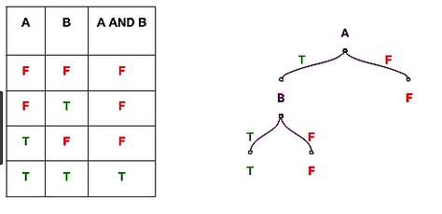
Decision tree algorithm is one of the most popular machine learning algorithm. It is a supervised machine learning algorithm, used for both classification and regression task. It is a model that uses set of rules to classify something.
Lets see decision tree with this simple example, It is normal “AND’ operation problem, where ‘A’, ‘B’ are features and “A and B” are corresponding labels.
If A=F then result=F
If A=T and B=T, then result=T
If A=T and B=F, then result = F
This is a an example of binary classifier. It classify “And” operation is ‘False’ or ‘True’.

Slide 5
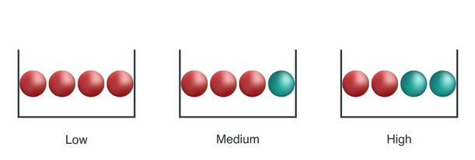
Impurity measures the homogeneity in the data sample. If the sample is homogeneous then sample are from same class.
Let’s understand Impurity with the following toy example,
From above image, a ball is randomly drawn from each bowl. So how much information you needed to accurately tells the color of ball. So, left bowl needed less information as all of the ball is red colored, central bowl needed more information than left bowl to tell it accurately, and right bowl needed maximum information as both number of both color ball are same.
As information is measure of purity, so we can say that left bowl is pure node, middle is less impure and right is more impure.

Slide 6
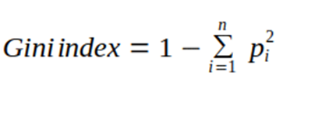
Gini index/ Gini impurity - impurity measures
Gini index is measure of inequality in sample. It has value between 0 and 1. Gini index of value 0 means sample are perfectly homogeneous and all element are similar, whereas, Gini index of value 1 means maximal inequality among elements. It is sum of the square of the probabilities of each class.

Slide 7
CART
It is used for generating both classification tree and regression tree.
It uses Gini index as metric/cost function to evaluate split in feature selection in case of classification tree.
It is used for binary classification.
Classification tree
A classification tree is an algorithm where the target variable is categorical. The algorithm is then used to identify the “Class” within which the target variable is most likely to fall. Classification trees are used when the dataset needs to be split into classes that belong to the response variable(like yes or no)

Slide 8
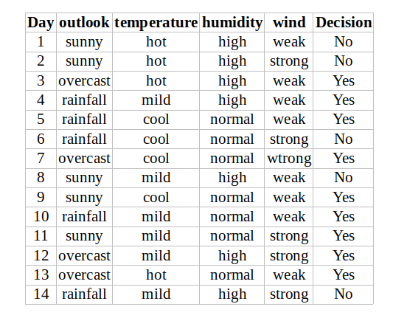
From data, outlook, temperature, humidity, wind are the features of data.

Slide 9
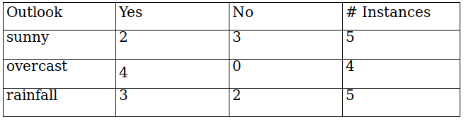
Outlook
Outlook is a nominal feature. it can take three value, sunny, overcast and rain.
Gini = 1 - (x/n)² - (y/n)²
Where
x is the number of positive answers(“YES")
n is the number of samples
y is the number of negative answers ("NO")
Gini index (outlook=sunny)= 1-(2/5)²-(3/5)² = 1- 0.16–0.36 = 0.48
Gini index(outlook=overcast)= 1- (4/4)²-(0/4)² = 1- 1- 0 = 0
Gini index(outlook=rainfall)= 1- (3/5)² -(2/5)² = 1- 0.36- 0.16 = 0.48
Now , we will calculate the weighted sum of Gini index for outlook features,
Gini(outlook) = (5/14)*0.48 + (4/14) *0 + (5/14)*0.48 = 0.342

Slide 10
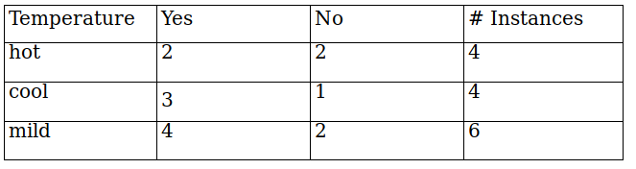
Temperature
Similarly, temperature is also a nominal feature, it can take three values, hot , cold and mild
Gini = 1 - (x/n)² - (y/n)²
Where
x is the number of positive answers(“YES")
n is the number of samples
y is the number of negative answers ("NO")
Gini(temperature=hot) = 1-(2/4)²-(2/4)² = 0.5
Gini(temperature=cool) = 1-(3/4)²-(1/4)² = 0.375
Gini(temperature=mild) = 1-(4/6)²-(2/6)² = 0.445
Now, the weighted sum of Gini index for temperature features can be calculated as,
Gini(temperature)= (4/14) *0.5 + (4/14) *0.375 + (6/14) *0.445 =0.439

Slide 11
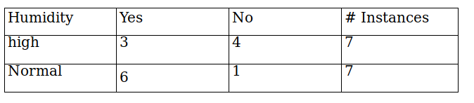
Humidity
Gini = 1 - (x/n)² - (y/n)²
Where
x is the number of positive answers(“YES")
n is the number of samples
y is the number of negative answers ("NO")
Humidity is a binary class feature , it can take two value high and normal.
Gini(humidity=high) = 1-(3/7)²-(4/7)² = 0.489
Gini(humidity=normal) = 1-(6/7)²-(1/7)² = 0.244
Now, the weighted sum of Gini index for humidity features can be calculated as,
Gini(humidity) = (7/14) *0.489 + (7/14) *0.244=0.367

Slide 12
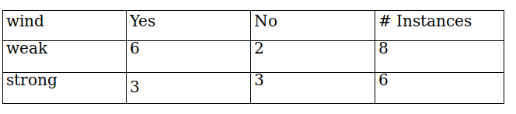
Wind
Gini = 1 - (x/n)² - (y/n)²
Where
x is the number of positive answers(“YES")
n is the number of samples
y is the number of negative answers ("NO")
wind is a binary class feature , it can take two value weak and strong.
Gini(wind=weak)= 1-(6/8)²-(2/8)² = 0.375
Gini(wind=strong)= 1-(3/6)²-(3/6)²= 0.5
Now, the weighted sum of Gini index for wind features can be calculated as,
Gini(wind) = (8/14) *0.375 + (6/14) *0.5=0.428

Slide 13
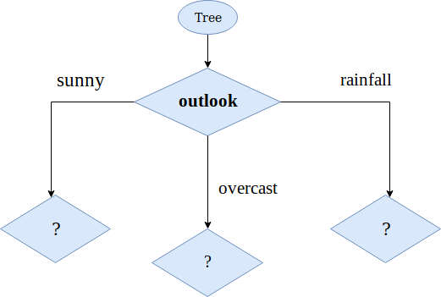
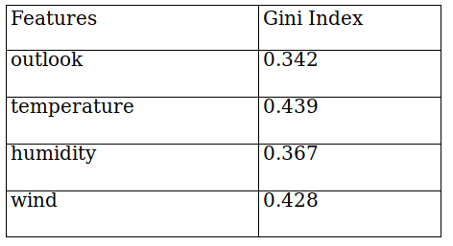
Decision for root node
So , the final decision of all the features
as we can seen that Gini index for outlook feature is lowest. So we get our root node.

Slide 14
Parameters
criterion-
The function to measure the quality of a split.
Splitter-
The strategy used to choose the split at each node.

Slide 15
Hyperparameter
max depth: This is the maximum number of children nodes that can grow out from the decision tree until the tree is cut off.
min_samples_split – Minimum number of samples a node must possess before splitting.
min_samples_leaf – Minimum number of samples a leaf node must possess.
max_leaf_nodes – Maximum number of leaf nodes a decision tree can have.
max_features – Maximum number of features that are taken into the account for splitting each node.

Slide 16
Applications
Advantages
Less Data Preparation
easy to interpret and visualize data patterns.
Versatility
accuracy
For quick Data insights.
In Blood Donors Classification.
For environmental and ecological data.
In the financial sectors.
image classification.
decision and strategy analysis.
for diagnosis.
in psychology for behavioral thinking analysis.
Disadvantages
Overfitting.
Feature Reduction & Data Resampling.
Optimization
.unstable.

Slide 17
Reference
https://corporatefinanceinstitute.com/resources/data-science/decision-tree/
https://medium.com/@ankitnitjsr13/math-behind-decision-tree-algorithm-2aa398561d6d
http://homepage.cs.uri.edu/faculty/hamel/courses/2016/spring2016/csc581/lecture-notes/32-decision-trees.pdf
https://www.datascienceprophet.com/understanding-the-mathematics-behind-the-decision-tree-algorithm-part-i/

Slide 18
THANK YOU

